Slide 1
Endpoints Operations
Monthly Operations Summary
JL IT
August 2022

Slide 2
Executive Summary
Incident Management saw incident volume rose in August (3,373). The first call resolution, or FCR, was 86.6%. The overall SLA goal across all teams was met at 91.2%.
Service Desk call volume remained rose to 2,880 in August. Calls answered within 30-, 60-, and 90-seconds goals were surpassed. Average speed to answer was 39 seconds. The abandonment rate goal for the month was also surpassed at 6.8%. SLA goals were met by the Service Desk with an overall SLA score of 97.4%.
Technology Operations assignment groups opened or received 467 incidents across the month. Worked to reduce unnecessary critical and error alerts. We continued to record resource uptimes.
Endpoint Engineering restored SCCM in July. Auto Pilot configuration and testing is nearing completion. Litera was rolled out to test locations.
Endpoint Projects NextGen continued to be on hold in July due to equipment shortages. Self Service Password Reset had a successful test and we are scheduling to deploy in the next several weeks. Initial amenities form for the Conference Room project has been configured in Service Now Test.

Slide 3
Incident Management Summary
Service Desk Summary
Technology Operations Summary
Endpoint Engineering Summary

Slide 4
Incident Management

Slide 5
Incident Statistics
3,373 incidents were opened during the month, across all groups within SNOW. 21.82% of incident volume were emails.
Phone: 2535
Email: 736
Self-Service: 56
Walk-in: 46
First contact resolution rose in August to 86.6% (as opposed to 81.8% in July).

Slide 6
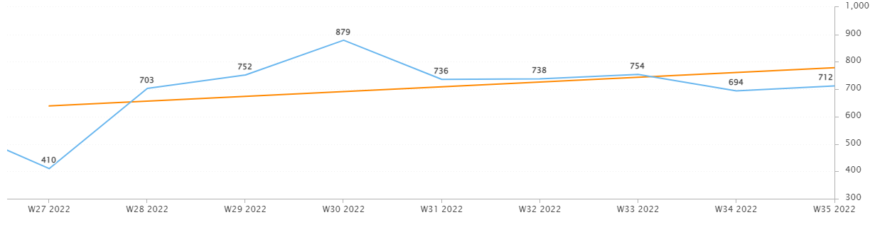
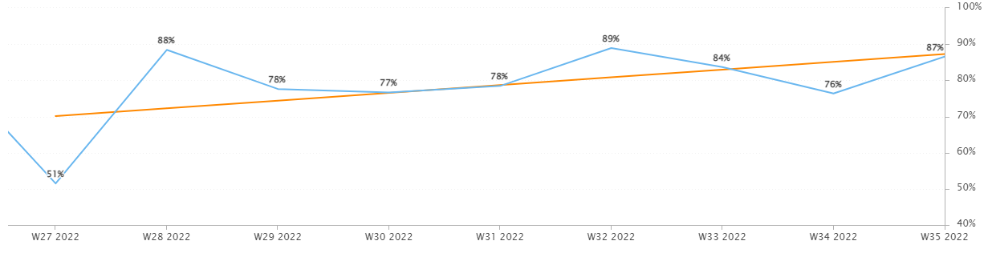
Incident Statistics
Incidents Opened by Week
Incidents opened by week continued to trend upward.
The percentage of incidents resolved the same day that they were opened trended upward in August.
Percentage of incidents resolved; same day opened.

Slide 7
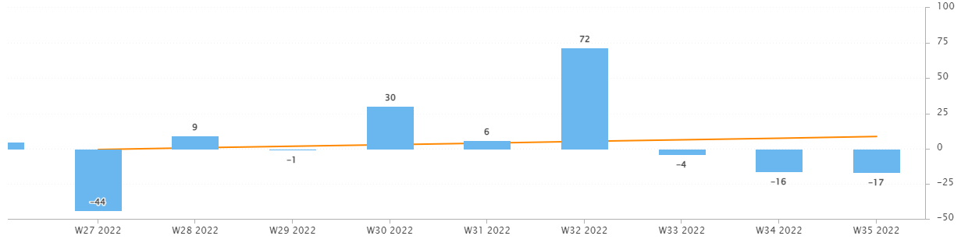
Incident Statistics
Open Incident Backlog Growth
Notes:
Backlog growth is a way of answering, “did we end the week with more or less incidents?”.

Slide 8
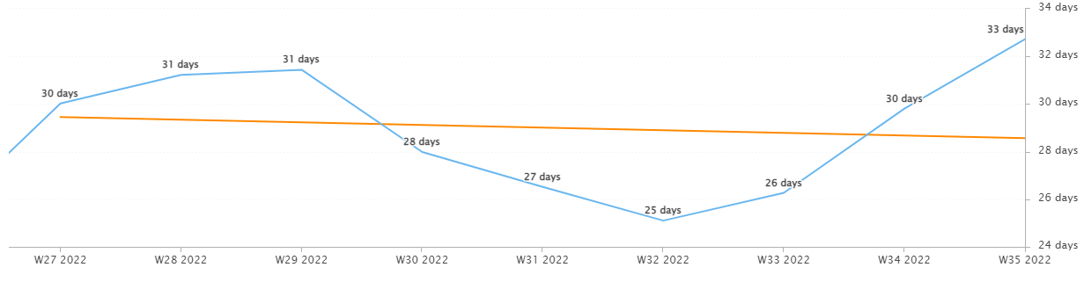
Incident Statistics
Average Age of Open Incidents
In August, the average age of open incidents trended downward.
Notes:
Please remind your teams to continue to work on their open incidents- this affects many of the previous slides as well as this one.

Slide 9
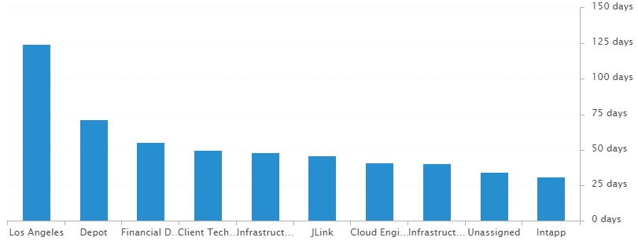
Incident Statistics
Average Age of Open Incidents by Assignment Group - as of the last day of the month

Slide 10
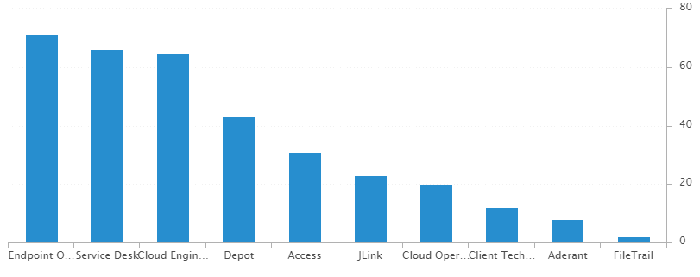
Incident Statistics
Open Incidents by Assignment Group - as of the last day of the month

Slide 11
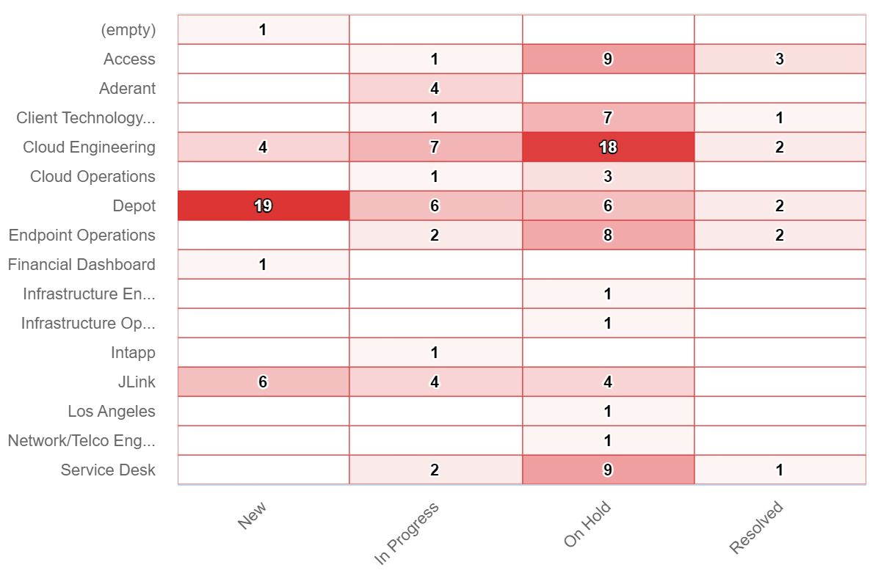
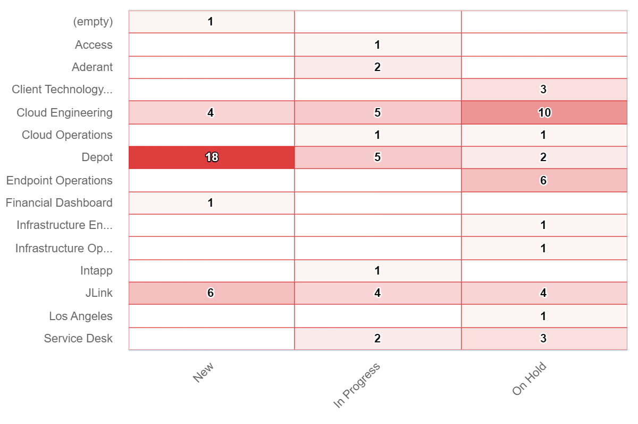
Incident Statistics
Open Incidents Older than 30 Days
Open Incidents not updated in last 30 days

Slide 12
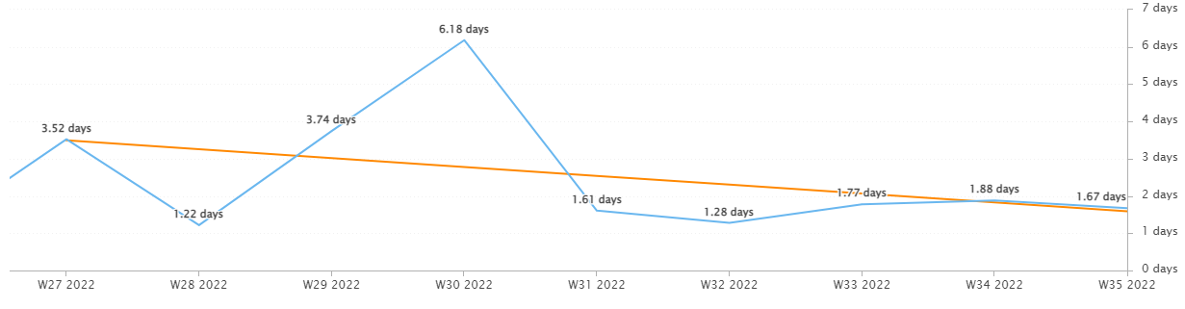
Incident Statistics
Average Resolution Time of All Resolved Incidents
The average resolution time trended downward across the month.

Slide 13
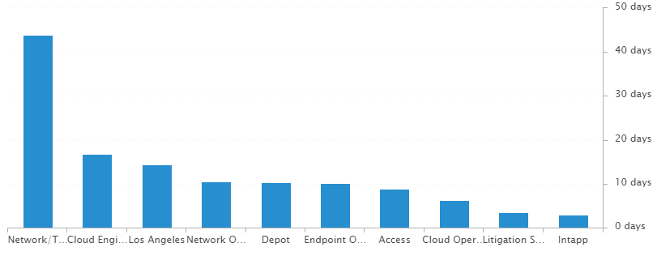
Incident Statistics
Average Resolution Time of Resolved Incidents, by Assignment Group

Slide 14
2022 SLA Goals & Actuals
Month | January | February | March | April | May | June | July | Aug | Sept | Oct | Nov | Dec
Goal | 90% | 90% | 90% | 90% | 90% | 90% | 90% | 90% | 90% | 90% | 90% | 90%
Actual | 88.8% | 88.1% | 92.7% | 92% | 90.6% | 93.9% | 91.6% | 91.2%
The Incident SLA goal in August was met across all teams.

Slide 15
Problem Statistics
There are currently 18 open Problems across teams.
3 are high priority.
15 are moderate priority or lower.

Slide 16
Service Desk

Slide 17
Year over Year Quarterly Results
Total incident and call volume reduced in Q2 2022 over 2020 and 2021.

Slide 18
Key Call Statistics
Call volume rose in August to 2,880 calls.
The abandonment rate monthly goal is 9%.
The goal was met, ending the month with 6.84%.
Notes:
~
There are several stats tracked for individual analysts as well as for the team and the org. Across the next few slides I’ll highlight some key statistics for the Service Desk team.

Slide 19
Key Call Statistics
The Service Desk met all 3 goals for each range. This correlates with the call volume and abandonment rates.
The goals for each time period:
70% of calls handled within 30 seconds.
75% of calls handled within 60 seconds.
80% of calls handled within 90 seconds.
Notes:
Over 75% of calls were handled within 30 seconds.
Over 80% were handled within 60 seconds.
Over 83% were handled within 90 seconds.
~
We track multiple metrics for calls handled- or how quickly a call is answered- within specific time periods. I’ve highlighted three here, calls handled within 30, 60, and 90 seconds.
The takeaway from these numbers should be that we are answering calls quickly which prevents calls from abandoning. Typically, we see the abandoned calls rise when these goals are not met- specifically the 60 seconds metric.

Slide 20
Key Call Statistics
The average speed to answer was 39 seconds which correlates with the trend of call volume & abandoned calls alongside the higher percentages for the calls handled within 30, 60, and 90 seconds.
Notes:
~
Average speed to answer is the average of how quickly all calls were answered by the Service Desk for the month.

Slide 21
Incident Statistics
Closed Monthly Data:
Incidents closed by SD: 2,849
Total Closed Incidents: 3,463
Closed by SD Percentage: 82.27%
Incidents closed by Service Desk, by Source:
Phone: 2,235
Email: 547
Self-Service: 24
Walk-in: 43
Notes:
~
The typical methods for contacting the Service Desk are phone and email, which explains the results in the incident source chart.
Self-Service we hope to expand over the next year and drive users towards generating their own incidents and using the JL Service Center more actively.
Walk-ins are low month-to-month with the split schedule for Return to Better. But from analyst feedback incidents for walk-ins are not being opened consistently. I aim to correct this over the rest of this year. I’ve also added it as a 2022 goal for each analyst within their reviews.

Slide 22
Incident Statistics
Top 5 Subcategories:
Microsoft Office (632)
NetDocuments (455)
Active Directory (235)
Power PDF (170)
Printer (126)
Top 5 Customers:
Christopher Gomez (27)
Suzanne Holderby (23)
Cheryl Sturgess (22)
David McLaughlin (17)
Barbara Bona (16)
~
Average Incident/employee/month: 1.82
Average Incident/new hire/month: 2.38
Notes:
Across the month _had the highest number of related incidents.
Top 5 customers in the month are listed here.
Looking at the chart, we’re tracking incident volume per new-hire per month and comparing this to last year.

Slide 23
2021 Service Desk SLA Statistics
Survey Response Comment Highlights:
“I believe the person who helped me was named Marcus -- He was incredibly helpful and professional.”
“Dan was very responsive and great.”
Taylor- “Great friendly assistance and service as always”
Stéphane- “We have a great IT team. Keep up the excellent work.”
“Blaise is great. Fantastic professionalism, friendliness and knowledge. I see him as the benchmark for support staff.”
“Chris is always great!”
September | Breached | Has not Breached | SLA %
Response | 105 | 2759 | 96.19%
Resolution | 38 | 2826 | 98.66%
Overall | 143 | 5585 | 97.44%
Response & Resolution SLA timers are determined by the Priority of the Incident.
Both Response and Resolution SLA reviewed on this slide are across all Priorities.
Notes:
Service level agreements/SLA
Response & Resolution SLA timers are determined by the Priority of the Incident.
Both Response and Resolution SLA reviewed on this slide are across all Priorities.
~ The Service Desk team is uniquely prepared to meet SLA goals. We generate incidents during calls, while emails generate their own incidents.

Slide 24
Knowledge Statistics
Top viewed articles, Self Service:
How do I contact the Service Desk?
How to install a network printer
Connecting Phone Services in Cisco Webex
How to add Outlook and Team Delegate Access
Top viewed articles, IT:
Escalation paths and category guide
TeamViewer: Remote control
JL Storage & Network Drives
Intapp Time Troubleshooting
Average Article rating: 4.65/5 Did you know?
1,971 searches were made from within the JL Service Center by 171 unique users.
These searches were across both Knowledge & Service Center.
An interesting search was “backpack”, as a user seemed to be searching to order branded JL backpacks.
Notes:
Knowledge within Service Now, is maintained by a few of us in the Service Desk team.
We evaluate resolved Incidents that have been flagged for knowledge.
On most of these flagged Incidents the fix or solution are not detailed by the escalated teams.
Knowledge is split into 2 sections. IT visible and Self-Service.
Please push your teams to write out the steps taken to resolve an issue, whenever possible.
This helps with knowledge but also helps when a user has a repeat issue, or the issue occurs for another user.
Reminder: your teams can generate their own knowledge articles. These will be used to increase our first call resolution and avoid escalating incidents.

Slide 25
Update & Reminder Highlights
OneDrive Account access: When a user is separated, via the form in Service Now, the manager may select who will receive access to the separated user’s OneDrive Account.
The user who receives access will receive a link via the task/email.
This is the only reason OneDrive account access is typically given.
A Knowledge Article has been added to more clearly describe this.
JL Core IT Passwords: A new password requirement has been added for IT folks. Our passwords now must be 15 characters long. This is already in effect, but you won’t be required to upgrade to a 15-character password until your next password reset.
Password Resets or Bypass codes: Following my email from July 29th, going forward we’ve been asked to use Duo to verify a user is who they claim to be prior to resetting their JL Account password or giving them a Duo Bypass code. Steps below and we’ll get this into knowledge.
Calendar Appointments: Some incidents have been escalated for an issue where a Teams meeting is being added to each calendar invite sent. Even when Webex is being selected.
This is not a bug in the add-in. A repair of office is not needed.
Instead, open Outlook Options>Calendar>Calendar Options>Deselect add online meetings to all meetings>Select Ok.
Cloud Engineering is looking to disable this via a script deployed via Intune.
Self Service Password Reset: An email was sent to the pilot sites asking them to self-enroll (See attached). I was notified this afternoon that there are a few issues they’re working to resolve. Just FYI, some users may call us as SSPR is not working as expected.
Notes:
Some highlights from the month’s U&R emails are listed here.
One to two emails are sent a week to the Service Desk reminding them, or updating them on, changes to existing workflows or policies. Quick notes sent via Teams are also rolled up into these emails to be sure that these points are not missed. All U&R emails are listed in Confluence for reference by other teams.

Slide 26
Areas of Improvement
Frequent Callers: Working to reduce volume from the most frequent customers of the Service Desk as well as New Hires with these three areas of focus.
OAs: Met with Martha Tanner to review our most frequent callers and to see if her team would find it useful to be notified when one of their staff makes it into our weekly or monthly top ten.
She suggested that instead of targeting specific users, review the most frequent questions from frequent users and send out training recommendations for the Office Administrators to circulate through their teams.
Then reevaluate and see if these most frequent customers improve.
Duo: New hires frequently have issues with first use of VPN because they do not have access to use it.
Looking to answer, “why do we not give all users rights to use VPN/Duo while in a hybrid work environment?
Training: Professional Development has said they would be happy to add any videos we provide to the new version of the new hire learning track.
Looking to developing a list of short video topics and record short trainings on these.
Surveys & Feedback: Though our Survey scores have remained positive, feedback on some of our newer staff members has been mixed.
Expected as they acclimate to JL.
Working with staff in 1:1s on specific areas of improvement.
Reviewing options to return to the QA process.

Slide 27
Technology Operations

Slide 28
Escalation Status

Slide 29
Escalation Baselines

Slide 30
Logic Monitor Alerts
Critical Alerts
Continue IDF/Server Room Temps in Denver & Miami
Adding longer SDT for Clocktimizer site refresh
Error Alerts
Devices not being placed in SDT
Silver Peak Errors clearing
CPU on Service Now and Varonis Servers (will be re-adjusted)

Slide 31
Resource Uptime
Resource | June | July | August
Aderant | 100% | 99.773% | 100%
Intapp Walls | 100% | 99.996% | 100%
JL - Home | 99.593% | 99.935% | 99.503%
J Link | 99.996% | 100 | 99.996%
NBI | 99.525% | 99.993% | 99.525%
Payments Credit Card | 99.957% | 99.764% | 99.957%
Dashboard | 100% | 100% | 100
Biscom | 99.995% | 99.967% | 99.997%
Citrix | 100% | 100% | 100%
VPN East | 99.997% | 99.979% | 99.997%
VPN West | 99.72% | 100 | 99.73%
Logic Monitor Collector Polling
JL – Home and NBI schedule maintenance ( Site wasn’t place in SDT)

Slide 32
Endpoint Engineering

Slide 33
Endpoint Analytics
•Overall score came in at 80 for August. With SCCM restored and operational, we can now stay on top of app updates and deliver new solutions.
•Startup and App Reliability holding at 74 and 77 and look to improve as both older hardware continues to be replaced and applications continue migrate to Intune.
• Work from Anywhere should begin to improve over the next quarter as more AAD PC’s join our fleet.

Slide 34
Endpoint Model Inventory
•Corrected issue(30days or less)with Intune reporting device counts. Numbers now reflect offline roster count. (2233 devices)
•NexGen resumes to replace our older hardware(HP G6’s and down) and remove HDDs from the environment will further increase our scores all around.
•906 total Surface Laptop 4s - Best performer
•16 Remaining Surface Pro 5s - Worst performer

Slide 35
Endpoint Model Performance
The introduction of Surface Pro 8’s will bring better performance and reliability to tablet seeking users.
With 51 remaining Pro 6’s set to be replaced in the coming month’s, our boot and log on time should increase our overall scores.

Slide 36
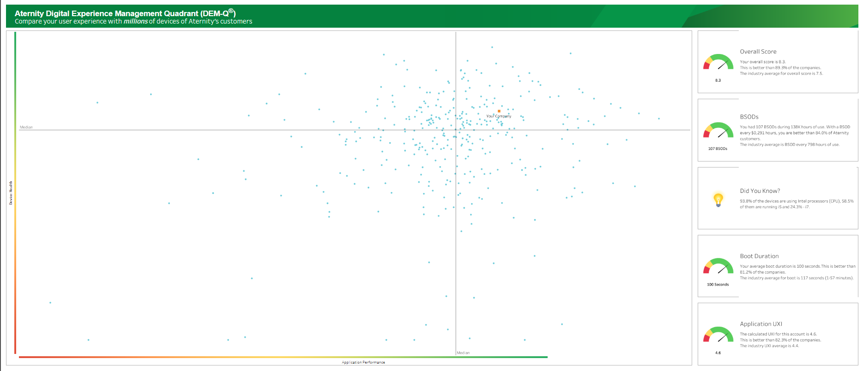
Aternity DEM-Q Performance
DEM-Q rose to 8.3, up 0.1 from July.
Boot duration fell to 100secs as the push to stay up to date from our update rings becomes more standard.
App UXI is still holding at 4.6,but now better than 81.2% of companies.

Slide 37
Windows 11 Testing
Currently 10-15 Core IT members testing our image with Windows 11 as an upgrade and bare metal deployment. Feedback so far has been good.
Moving to other users/workflows by years end to further test our environment against Windows 11.
Confluence Windows 11 Test Feedback Page

